Slide 1

Sauce & Spoon
Tablet Rollout
Impact Report

Slide 2
Executive Summary
Tablet Rollout was an idea developed to improve customer experience aligned with an aimed enjoyable dinner experience in under an hour, according to Sauce & Spoon mission. In addition, the project needed also to increase results in profitability. The bar section of two restaurants of the company, North and Downton, were chosen as ideal location to start.
The main goals pursued was improving customer satisfaction, reduce time table turn by 30 minutes, supporting an increase by 10% of daily guests counts, and reduce waste of food by 25%. The project achieved all of its main goals proposed and walked a step further, for instance the waste of food was reduced by 50%.
A very important project milestone was a pilot rollout ran before the official launch, which lifted important aspects of the project to be analyzed and adapted, leading to a better experience onwards. While a survey execute after the pilot rollout showed 72% of customer satisfaction, after adaptations it was achieved the mark of 86%.
Revenue was increased by 20% past 3 months of the launching, a very significant increasing reflex of daily guests increasing.
The reduction of food waste was only possible after integrating a better dialogue and establishing a blameless feeling towards the situation, what made possible drive everyone’s effort to a common goal. Therefore an important lesson to apply in the future is facilitate this dialogue since the beginning. Another important lesson is that floor staff remain important and tablets are a complement to the service, and should not be considered a substitute at all. Results of surveys showed them important in the dialogue and instruction to customer, besides carry on the process of checking out when customers want to pay by card.
Next steps for this initiative includes expanding the project to implement tablets in other locations, and continue to track customers experience and satisfaction.

Slide 3
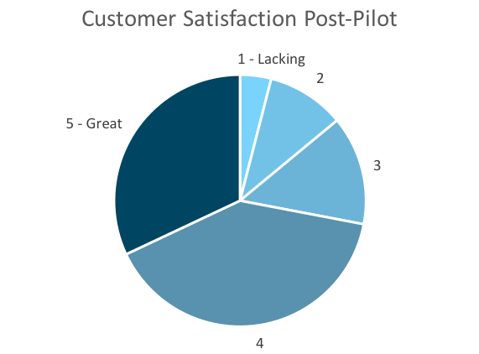
Customer Satisfaction: Pilot
Q. On a scale of 1-5, please rate your experience with the tablet overall.
This pie chart illustrates the results from the post-pilot survey.
72% of respondents indicated a customer satisfaction score of 4 or 5.
Notes:
First pie chart: Results from the post-pilot survey
Second pie chart: Results from the post-launch survey, after making changes
Satisfaction has gone up from 72% (4 and 5 rating) to 86% (4 and 5 rating)
Post-pilot data:
1 - Lacking 2 4%
2 5 10%
3 7 14%
4 20 40%
5 - Great 16 32%
Post-launch data:
1 - Lacking 1 2%
2 2 4%
3 4 8%
4 22 44%
5 - Great 21 42%

Slide 4
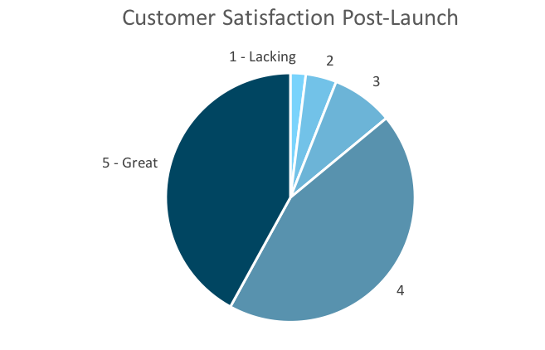
Customer Satisfaction: Launch
Q. On a scale of 1-5, please rate your experience with the tablet overall.
This pie chart illustrates the results from the post-launch survey.
86% of respondents indicated a customer satisfaction score of 4 or 5. This is a 14% increase.
Notes:
First pie chart: Results from the post-pilot survey
Second pie chart: Results from the post-launch survey, after making changes
Satisfaction has gone up from 72% (4 and 5 rating) to 86% (4 and 5 rating)
Post-pilot data:
1 - Lacking 2 4%
2 5 10%
3 7 14%
4 20 40%
5 - Great 16 32%
Post-launch data:
1 - Lacking 1 2%
2 2 4%
3 4 8%
4 22 44%
5 - Great 21 42%

Slide 5
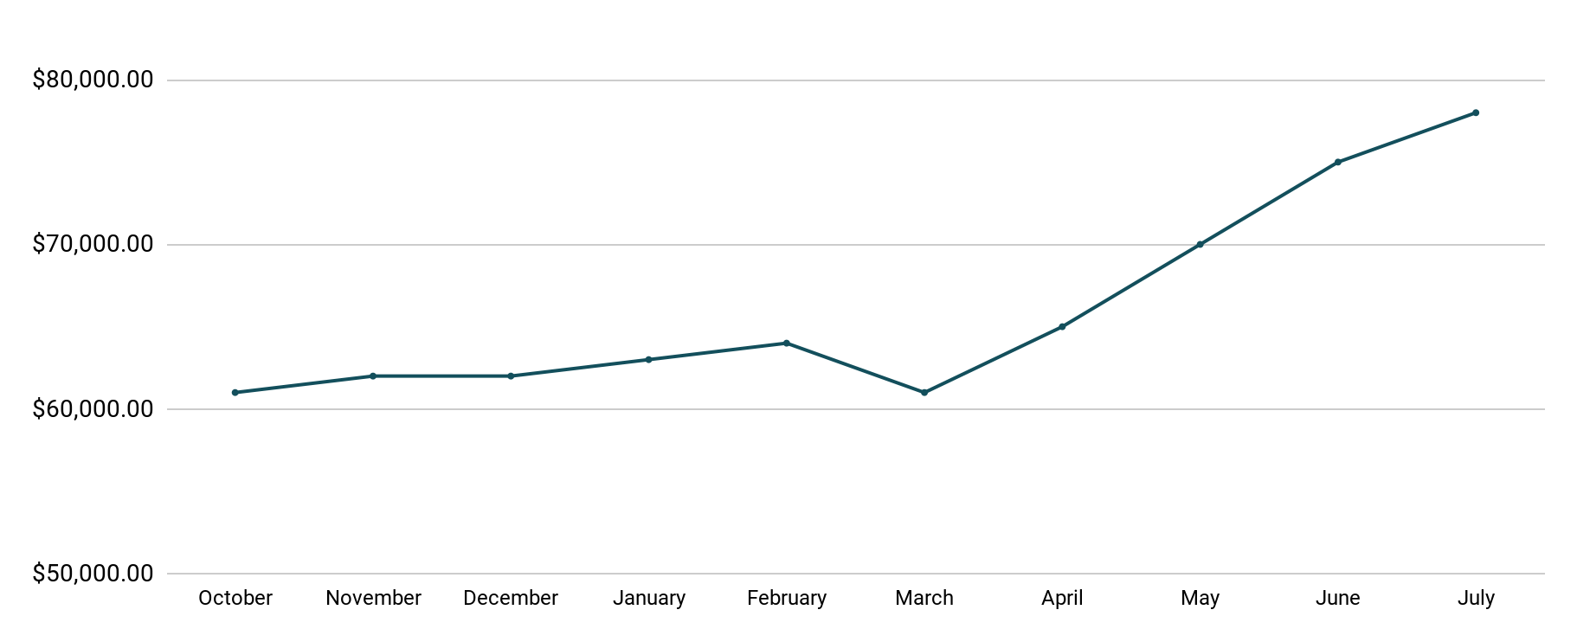
Revenue
Tablet Launch April 23
This is a chart of Sauce & Spoon revenue, showing that after tablet implementation, revenue increased.
July revenue was up to 20% over April’s monthly revenue.
Notes:
This is a chart of Sauce & Spoon revenue, showing that after tablet implementation, revenue increased. December revenue was up to 20% over September’s monthly revenue.
Sales data:
October
$61,000.00
November
$62,000.00
December
$62,000.00
January
$63,000.00
February
$64,000.00
March
$61,000.00
April
$65,000.00
May
$70,000.00
June
$75,000.00
July
$78,000.00

Slide 6
What Worked: Key Accomplishments
Decreased table turn time
Implementation of the tablets increased the average daily guest count by 10%.
Tablets also decreased wait time by 30 minutes.
Decreased food waste
Tablets identified who was receiving an incorrect order.
Kitchen staff has taken the initiative to correct orders and decrease food waste by 50%.
Increased customer satisfaction
After the pilot, customer satisfaction was at 72%.
Once we implemented improvements based on feedback, customer satisfaction increased to 86%.
Increased sales
Our monthly revenue has increased steadily since the tablet rollout, upwards of 20% since September/pre-rollout.
Tablets also helped boost revenue during the holiday season.

Slide 7
Next Steps: Looking Forward
Initiative | Action | Date
Implement tablets in more locations | Create new project plan for new location installation | Q2
Continue to track customer experience and satisfaction | Continue surveying/ gathering data through various means | Ongoing
Expand tablet features | Investigate new features like social media integration, reservations, videos, etc. | Q4

Slide 8
Appendix
Access all resources here.
Notes:
Insert link to your shared drive or a shared folder with all of the relevant project artifacts

